Slide 1
PRECISION AGRICULTURE: OPTIMIZING CROP MANAGEMENT THROUGH CNN-BASED FERTILIZER RECOMMENDATIONS
Guide:
Presented by :
B. Dhinesha
M. Mahalakshmi.
G. Priya.
G. Vinodha.
Mrs.PORKODI.C,
AP/CSE.
MAHENDRA ENGINEERING COLLEGE FOR WOMEN
THIRUCHENGODE,NAMAKKAL.
Date:10.05.2024

Slide 2
Contents
Abstract
Introduction
Existing system
Disadvantage
Proposed System
Advantage
System Architecture
Modules
Project Description
Sample code
Output
Conclusion
Future Enhancement
Reference

Slide 3
Abstract
This study proposes a novel approach to crop management using Convolutional Neural Networks (CNNs) for accurate and efficient fertilizer recommendations.
Traditional methods of fertilizer application often lack precision, leading to resource waste or suboptimal crop yields.
The CNN-based model integrates remote sensing data, soil information, and historical crop performance to generate personalized fertilizer recommendations for different regions and crop types.
The system aims to predict crop yields accurately and provide optimized fertilizer recommendations, aiding farmers in making informed decisions for improved agricultural outcomes.

Slide 4
Introduction
Agriculture has evolved to meet global demands, with innovations like AI and CNNs transforming traditional practices.
These technologies offer precision in crop management, enhancing efficiency and sustainability.
AI-CNN-based farming enables monitoring of crop health, disease detection, and optimized irrigation, reducing environmental impact.
This revolution improves yields, lowers costs, and contributes to global sustainability goals.

Slide 5
Existing System
The system uses SVM to predict crop yield, registering users who input soil details.
Data collection includes location, weather, plant, area, and productivity.
The dataset from Kaggle contains features like calcium, magnesium, potassium, etc., and is categorized into four classes based on soil, weather, and crop properties.
Pre-processing involves removing redundant and missing values.
The model, trained with SVM, is saved with the dataset and processes user queries, predicting crops and suggesting fertilizers for better growth.

Slide 6
Disadvantage
• The SVM algorithm may not accurately predict different regions or conditions due to its reliance on a specific dataset.
• The system's reliance on Kaggle data may introduce biases and limitations, potentially leading to suboptimal results.
• Requiring farmers to register on the website may limit its reach and usability.
• Focusing on predicting maximum crop yield may neglect other crops, hindering overall agricultural optimization.
• The system collects and stores sensitive agricultural and location data, raising concerns about user protection.

Slide 7
Proposed System
Crop yield prediction and fertilizer recommendations are vital for modern agriculture.
Convolutional Neural Networks (CNNs) excel at analyzing agricultural data, especially satellite imagery.
The system gathers a dataset including yield history, soil properties, weather, and crop details.
Python aids in integrating CNNs with datasets for efficient processing.
Real-world data validates the system's accuracy, with model training involving data splitting, hyper parameter tuning, and metric evaluation.

Slide 8
The system also recommends optimal fertilizer combinations for sustainable farming.
It aims to improve precision agriculture, offering farmers a data-driven decision-making tool.
The system covers data pre-processing, CNN model development, feature engineering, and fertilizer recommendations.
Once validated, it can be deployed for real-time predictions, optimizing crop production sustainably.

Slide 9
Advantage
Optimized Resource Usage: CNNs provide tailored fertilizer application suggestions, minimizing waste and environmental impact.
Environmental Sustainability: Integration with agricultural data allows for precise assessment of crop health, growth stages, and potential yield.
Data-Driven Decision Making: Incorporates factors affecting crop yield, enhancing productivity and long-term planning.
Efficient Integration with Python Programming: Python facilitates efficient integration of CNN models with agricultural datasets, ensuring streamlined data processing and model training.

Slide 10
System Architecture
DATA BASE
DATA COLLECTION
DATA PREPROCESSING
FEATURE EXTRACTION
MODEL DEVELOPMENT
CNN
TRAINING THE MODEL
EVALUATION AND FINE-TUNING
CROP FIELD PREDICTION
FERTILIZER RECOMMANDATION

Slide 11
Project Description
The CNN model is trained using historical data, fine-tuning hyper parameters to prevent over fitting, and using appropriate evaluation metrics such as MAE, RMSE, or coefficient of determination (R-squared) to assess its accuracy in predicting crop yield.
The proposed methodology includes data preprocessing, CNN model development, feature engineering, fertilizer recommendation system, model training and validation, and model evaluation and deployment.
The trained model is evaluated using the test set and assessed for its performance in predicting crop yield and providing accurate fertilizer recommendations. Once satisfied, it can be deployed in a production environment for real-time predictions and recommendations for farmers.

Slide 12
Modules
Dataset
Crop yield prediction and fertilizer recommendation are crucial aspects of precision agriculture, aiming to optimize resource utilization and enhance agricultural productivity.
Feature Extraction
* Dimensionality Reduction
* Information Retention
* Dimensionality Reduction Techniques

Slide 13
CNN Model Development
*The term "convolution" in CNN refers to the mathematical function of convolution, which involves multiplying two functions to produce a third function.
*This process is used to extract features from images, which are then separated and identified through a process called feature extraction.
*The CNN network consists of many pairs of convolutional or pooling layers, with a fully connected layer that predicts the image's class based on the features extracted in previous stages.

Slide 14
Sample source code
# Importing libraries
from __future__ import print_function
import pandas as pd
import jumpy as np
import matplotlib.pyplot as plt
import seaborn as sns
from sklearn.metrics import classification_report
from sklearn import metrics
from sklearn import tree
import warnings
warnings.filterwarnings('ignore')
df = pd.read_csv('../Data-processed/crop-recommendation.csv')
df.head()
df.tail()
df.size
df.shape
df.columns
df['label'].unique()
df.dtypes
df['label'].value_counts()
sns.heatmap(df.corr(),annot=True)
features = df[['N', 'P','K','temperature', 'humidity', 'ph', 'rainfall']]
target = df['label']
#features = df[['temperature', 'humidity', 'ph', 'rainfall']]
labels = df['label']
# Initialzing empty lists to append all model's name and corresponding name
acc = []
model = []
# Splitting into train and test data
from sklearn.model_selection import train_test_split
Xtrain, Xtest, Ytrain, Ytest = train_test_split(features,target,test_size = 0.2,random_state =2)
from sklearn.tree import DecisionTreeClassifier
DecisionTree = DecisionTreeClassifier(criterion="entropy",random_state=2,max_depth=5)
DecisionTree.fit(Xtrain,Ytrain)
predicted_values = DecisionTree.predict(Xtest)
x = metrics.accuracy_score(Ytest, predicted_values)
acc.append(x)
model.append('Decision Tree')
print("DecisionTrees's Accuracy is: ", x*100)

Slide 15
print(classification_report(Ytest,predicted_values)
from sklearn.model_selection import cross_val_score
# Cross validation score (Decision Tree)
score = cross_val_score(DecisionTree, features, target,cv=5)
score
import pickle
# Dump the trained Naive Bayes classifier with Pickle
DT_pkl_filename = '../models/DecisionTree.pkl'
# Open the file to save as pkl file
DT_Model_pkl = open(DT_pkl_filename, 'wb')
pickle.dump(DecisionTree, DT_Model_pkl)
# Close the pickle instances
DT_Model_pkl.close()
from sklearn.ensemble import RandomForestClassifier
RF = RandomForestClassifier(n_estimators=20, random_state=0)
RF.fit(Xtrain,Ytrain)
predicted_values = RF.predict(Xtest)
x = metrics.accuracy_score(Ytest, predicted_values)
acc.append(x)
model.append('RF')
print("RF's Accuracy is: ", x)
print(classification_report(Ytest,predicted_values))
# Cross validation score (Random Forest)
score = cross_val_score(RF,features,target,cv=5)
score
import pickle
# Dump the trained Naive Bayes classifier with Pickle
RF_pkl_filename = '../models/RandomForest.pkl'
# Open the file to save as pkl file
RF_Model_pkl = open(RF_pkl_filename, 'wb')
pickle.dump(RF, RF_Model_pkl)
# Close the pickle instances
RF_Model_pkl.close()
accuracy_models = dict(zip(model, acc))
for k, v in accuracy_models.items():
print (k, '-->', v)
data = np.array([[104,18, 30, 23.603016, 60.3, 6.7, 140.91]])
prediction = RF.predict(data)
print(prediction)
data = np.array([[83, 45, 60, 28, 70.3, 7.0, 150.9]])
prediction = RF.predict(data)
print(prediction)

Slide 16
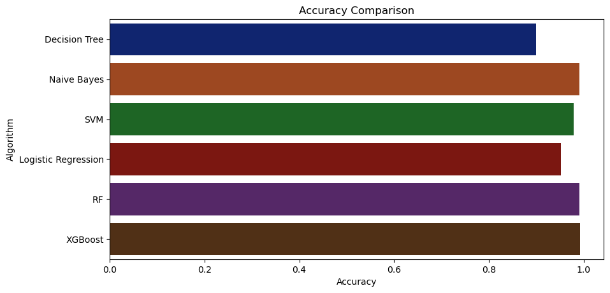
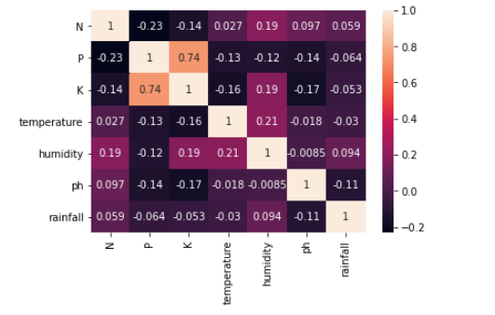
Sample screenshots

Slide 17
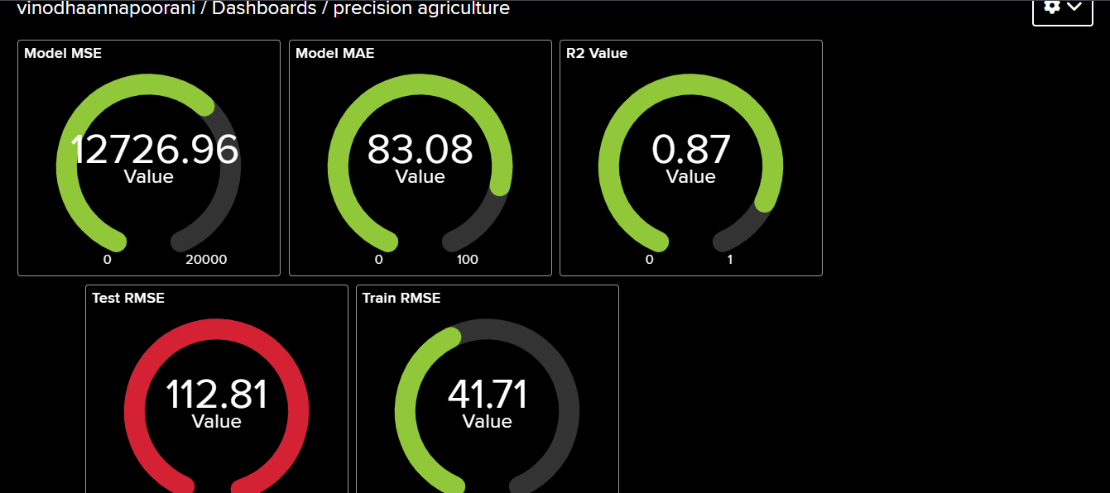

Slide 18
Conclusion
In conclusion, the proposed system introduces a novel approach to crop management through the application of Convolutional Neural Networks (CNNs) for accurate and efficient fertilizer recommendations.
By integrating remote sensing data, soil information, and historical crop performance, the CNN-based model delivers personalized fertilizer recommendations for different regions and crop types.
The system not only demonstrates its predictive capabilities through rigorous testing against real-world agricultural datasets but also incorporates a fertilizer recommendation component to promote sustainable and resourceefficient farming practices.

Slide 19
The use of CNN technology, extensive datasets, and Python programming establishes an advanced framework for crop yield prediction and fertilizer recommendation, contributing significantly to the advancement of precision agriculture.
Overall, the proposed system serves as a comprehensive tool for farmers to make informed, data-driven decisions, aiming to optimize crop production while minimizing environmental impact and resource usage in the face of evolving challenges.

Slide 20
Future Enhancement
TURE DIRECTIONS The success of the precision agriculture system opens up opportunities for further research and development.
Future directions may include expanding the system to support additional crops, integrating real-time sensor data for dynamic recommendations, and incorporating feedback mechanisms for continuous improvement.
Collaboration with agricultural stakeholders, research institutions, and technology partners can help validate the system's efficacy in real-world settings and facilitate its adoption at scale.

Slide 21
References
1. Atim, P., Birojjo, D.F., Namuganga, J., Nakyeyune, M.B. and Opio, G., “AI driven farm bot for crop health monitoring and disease detection,” 2023.
2. Dhanya, V.G., Subeesh, A., Kushwaha, N.L., Vishwakarma, D.K., Kumar, T.N., Ritika, G. and Singh, A.N., “Deep learning based computer vision approaches for smart agricultural applications,” Artificial Intelligence in Agriculture, 2022.
3. Kamble, R., Garg, N., & Bhardwaj, A. (2021). "Applications of Artificial Intelligence and Machine Learning in Agriculture: A Review." In 2021 5th International Conference on Computing Methodologies and Communication (ICCMC) (pp. 1-5). IEEE.

